Slide 1

Chapter 9
Network Management
A note on the use of these ppt slides:
We’re making these slides freely available to all (faculty, students, readers). They’re in PowerPoint form so you can add, modify, and delete slides (including this one) and slide content to suit your needs. They obviously represent a lot of work on our part. In return for use, we only ask the following:
If you use these slides (e.g., in a class) in substantially unaltered form, that you mention their source (after all, we’d like people to use our book!)
If you post any slides in substantially unaltered form on a www site, that you note that they are adapted from (or perhaps identical to) our slides, and note our copyright of this material.
Thanks and enjoy! JFK/KWR
All material copyright 1996-2009
J.F Kurose and K.W. Ross, All Rights Reserved
Computer Networking: A Top Down Approach ,
5th edition.
Jim Kurose, Keith Ross
Addison-Wesley, April 2009.

Slide 2
Chapter 9: Network Management
Chapter goals:
introduction to network management
  motivation
  major components
Internet network management framework
  MIB: management information base
  SMI: data definition language
  SNMP: protocol for network management
  security and administration
presentation services: ASN.1

Slide 3
Chapter 9 outline
What is network management?
Internet-standard management framework
  Structure of Management Information: SMI
  Management Information Base: MIB
  SNMP Protocol Operations and Transport Mappings
  Security and Administration
ASN.1

Slide 4

What is network management?
autonomous systems (aka “network”): 100s or 1000s of interacting hardware/software components
other complex systems requiring monitoring, control:
  jet airplane
  nuclear power plant
  others?
"Network management includes the deployment, integration
and coordination of the hardware, software, and human
elements to monitor, test, poll, configure, analyze, evaluate,
and control the network and element resources to meet the
real-time, operational performance, and Quality of Service
requirements at a reasonable cost."

Slide 5

Infrastructure for network management
definitions:
managing entity
agent
data
managing
entity
managed devices contain
managed objects whose
data is gathered into a
Management Information
Base (MIB)
data
managed device
agent
data
network
management
protocol
managed device
agent
data
agent
data
managed device
managed device

Slide 6
Network Management standards
OSI CMIP
Common Management Information Protocol
designed 1980’s: the unifying net management standard
too slowly standardized
SNMP: Simple Network Management Protocol
Internet roots (SGMP)
started simple
deployed, adopted rapidly
growth: size, complexity
currently: SNMP V3
de facto network management standard

Slide 7
Chapter 9 outline
What is network management?
Internet-standard management framework
  Structure of Management Information: SMI
  Management Information Base: MIB
  SNMP Protocol Operations and Transport Mappings
  Security and Administration
ASN.1

Slide 8
SNMP overview: 4 key parts
Management information base (MIB):
  distributed information store of network management data
Structure of Management Information (SMI):
  data definition language for MIB objects
SNMP protocol
  convey manager<->managed object info, commands
security, administration capabilities
  major addition in SNMPv3

Slide 9
SMI: data definition language
Purpose: syntax, semantics of management data well-defined, unambiguous
base data types:
  straightforward, boring
OBJECT-TYPE
  data type, status, semantics of managed object
MODULE-IDENTITY
  groups related objects into MIB module
Basic Data Types
INTEGER
Integer32
Unsigned32
OCTET STRING
OBJECT IDENTIFIED
IPaddress
Counter32
Counter64
Guage32
Time Ticks
Opaque

Slide 10
SNMP MIB
MIB module specified via SMI
MODULE-IDENTITY
(100 standardized MIBs, more vendor-specific)
MODULE
OBJECT TYPE:
OBJECT TYPE:
OBJECT TYPE:
objects specified via SMI
OBJECT-TYPE construct

Slide 11
SMI: Object, module examples
OBJECT-TYPE: ipInDelivers
MODULE-IDENTITY: ipMIB
ipMIB MODULE-IDENTITY
LAST-UPDATED “941101000Z”
ORGANZATION “IETF SNPv2
Working Group”
CONTACT-INFO
“ Keith McCloghrie
……”
DESCRIPTION
“The MIB module for managing IP
and ICMP implementations, but
excluding their management of
IP routes.”
REVISION “019331000Z”
………
::= {mib-2 48}
ipInDelivers OBJECT TYPE
SYNTAX Counter32
MAX-ACCESS read-only
STATUS current
DESCRIPTION
“The total number of input
datagrams successfully
delivered to IP user-
protocols (including ICMP)”
::= { ip 9}

Slide 12
MIB example: UDP module
Object ID Name Type Comments
1.3.6.1.2.1.7.1 UDPInDatagrams Counter32 total # datagrams delivered
at this node
1.3.6.1.2.1.7.2 UDPNoPorts Counter32 # underliverable datagrams
no app at portl
1.3.6.1.2.1.7.3 UDInErrors Counter32 # undeliverable datagrams
all other reasons
1.3.6.1.2.1.7.4 UDPOutDatagrams Counter32 # datagrams sent
1.3.6.1.2.1.7.5 udpTable SEQUENCE one entry for each port
in use by app, gives port #
and IP address

Slide 13
SNMP Naming
question: how to name every possible standard object (protocol, data, more..) in every possible network standard??
answer: ISO Object Identifier tree:
  hierarchical naming of all objects
  each branchpoint has name, number
1.3.6.1.2.1.7.1
ISO
ISO-ident. Org.
US DoD
Internet
udpInDatagrams
UDP
MIB2
management

Slide 14
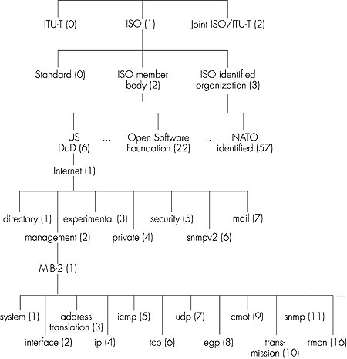
OSI
Object
Identifier
Tree
Check out www.alvestrand.no/harald/objectid/top.html

Slide 15
SNMP protocol
Two ways to convey MIB info, commands:
managing
entity
managing
entity
request
trap msg
response
agent
data
agent
data
Managed device
Managed device
request/response mode
trap mode

Slide 16
SNMP protocol: message types
Message type
Function
GetRequest
GetNextRequest
GetBulkRequest
Mgr-to-agent: “get me data”
(instance,next in list, block)
InformRequest
Mgr-to-Mgr: here’s MIB value
SetRequest
Mgr-to-agent: set MIB value
Response
Agent-to-mgr: value, response to
Request
Trap
Agent-to-mgr: inform manager
of exceptional event

Slide 17
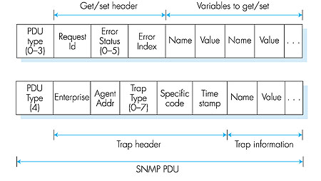
SNMP protocol: message formats

Slide 18
SNMP security and administration
encryption: DES-encrypt SNMP message
authentication: compute, send MIC(m,k): compute hash (MIC) over message (m), secret shared key (k)
protection against playback: use nonce
view-based access control
  SNMP entity maintains database of access rights, policies for various users
  database itself accessible as managed object!

Slide 19
Chapter 9 outline
What is network management?
Internet-standard management framework
  Structure of Management Information: SMI
  Management Information Base: MIB
  SNMP Protocol Operations and Transport Mappings
  Security and Administration
The presentation problem: ASN.1

Slide 20
The presentation problem
Q: does perfect memory-to-memory copy solve “the communication problem”?
A: not always!
struct {
char code;
int x;
} test;
test.x = 256;
test.code=‘a’
test.code
test.x
a
00000001
00000011
test.code
test.x
a
00000011
00000001
host 1 format
host 2 format
problem: different data format, storage conventions

Slide 21
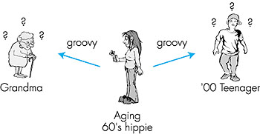
A real-life presentation problem:
grandma
2007 teenager
aging 60’s
hippie

Slide 22
Presentation problem: potential solutions
1. Sender learns receiver’s format. Sender translates into receiver’s format. Sender sends.
      real-world analogy?
      pros and cons?
2. Sender sends. Receiver learns sender’s format. Receiver translate into receiver-local format
      real-world-analogy
      pros and cons?
3. Sender translates host-independent format. Sends. Receiver translates to receiver-local format.
      real-world analogy?
      pros and cons?

Slide 23
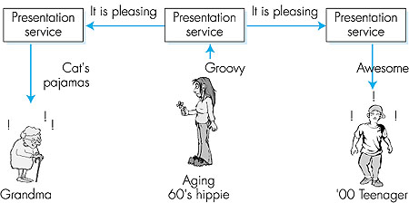
Solving the presentation problem
1. Translate local-host format to host-independent format
2. Transmit data in host-independent format
3. Translate host-independent format to remote-host format
aging 60’s
hippie
grandma
2007 teenager

Slide 24
ASN.1: Abstract Syntax Notation 1
ISO standard X.680
  used extensively in Internet
  like eating vegetables, knowing this “good for you”!
defined data types, object constructors
  like SMI
BER: Basic Encoding Rules
  specify how ASN.1-defined data objects to be transmitted
  each transmitted object has Type, Length, Value (TLV) encoding

Slide 25
TLV Encoding
Idea: transmitted data is self-identifying
  T: data type, one of ASN.1-defined types
  L: length of data in bytes
  V: value of data, encoded according to ASN.1 standard
Tag Value Type
1
2
3
4
5
6
9
Boolean
Integer
Bitstring
Octet string
Null
Object Identifier
Real

Slide 26
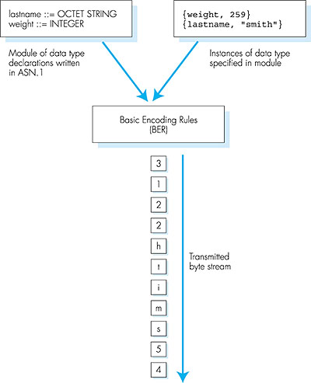
TLV encoding: example
Value, 259
Length, 2 bytes
Type=2, integer
Value, 5 octets (chars)
Length, 5 bytes
Type=4, octet string

Slide 27
Network Management: summary
network management
  extremely important: 80% of network “cost”
  ASN.1 for data description
  SNMP protocol as a tool for conveying information
Network management: more art than science
  what to measure/monitor
  how to respond to failures?
  alarm correlation/filtering?

